Slide 1

VECTO-DEV
14.05.2019
Gearshift Models

Slide 2
Gearshift Strategies
The following gearshift strategies are implemented in this development release
AMT
Classic AMT gearshift strategy (as in the current official VECTO version)
ACEA/Scania proposed gearshift strategy
TUG proposed gearshift strategy (FC-based)
AT
Classic AT gearshift strategy (as in the current official VECTO version)
Voith proposed gearshift strategy
TUG proposed gearshift strategy (FC-based

Slide 3
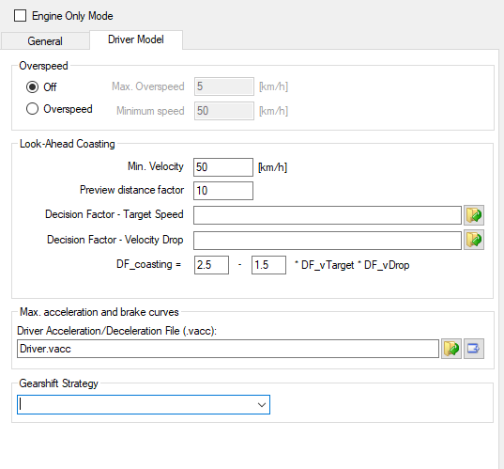
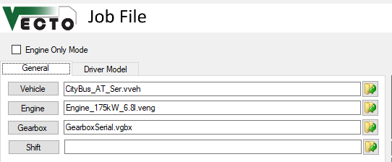
Selecting Gearshift Strategy
The Job-Window contains two additional input fields
Gearshift Strategy on the ‘Driver Model’ tab allows to select from applicable gearshift strategies (AMT/AT)
On the general tab, an additional file needs to be provided with parameters for the selected shift strategy (details see later)
By default (and in declaration mode) the ‘classic’ VECTO gearshift strategies are used
These do not need an additional file with the shift parameters (shift lines can be defined in engineering mode for every gear in the gearbox window)
Note: the shift parameter file (and all referenced files) can not be edited in the GUI! Please use a text editor (e.g., notepad++ or notepad) to change certain parameters. You can use the provided examples as starting point

Slide 4
Classic AMT Gearshift Strategy
Based on upshift and downshift lines which are calculated based on certain parameters of the engine (idling speed, full-load curve)
For details please see the VECTO user manual

Slide 5
ACEA/Scania AMT Gearshift Strategy
The principle is described in ‘Scania_2018-03-29_Prototype-TCU-VECTO.pdf’ and ‘Scania_2018-06-20_VECTO--Transmission-Control-Unit.pdf’
The documentation of the Matlab implementation is provided in ‘Scania_Transmission Control Unit_Matlab.pdf’
The parameters required for this gearshift strategy are documented in ‘Scania_2018-11-02_Settings-TCU-VECTO.pdf’

Slide 6
ACEA/Scania AMT Gearshift Strategy Parameter
The following parameters have to be provided in the shift parameter file (see for example "Examples\Class5_Tractor_4x2_AMT_ACEA\ShiftParameters.vtcu")
Some of the parameters are lookup-tables in CSV format
StartSpeed
StartAcceleration
GearResidenceTime
Dn_Tq99L_high_min_1
Dn_Tq99L_high_min_2
GearRangeUp
GearRangeDown
LookBackDriver
DriverAccelerationLookBackInterval
DriverAccelerationThresholdLow
P_card_avg_threshold
P_card_curr_threshold
Diff_curr_targ_vel
EngineSpeedHighDriveOffFactor
Rating_current_gear
AccelerationReserveLookup
ShareTorque99L
PredictionDurationLookup
ShareIdleLow
ShareEngineHigh

Slide 7
TUG FC-Based AMT Gearshift Strategy
The shift strategy is based on gearshift lines for upshift and downshift (similar to the classic VECTO gearshift strategy)
Allow early upshifts if the current engine operating point is within the gearshift lines if the following criteria are met:
Upshift: i_{gear+1} <= RatioEarlyUpshiftFC AND
FC_{gear +1} < FC_{gear} * Rating_current_gear
Allow early downshifts if the current engine operating point is within the gearshift lines if the following criteria are met:
Downshift: i_{gear-1} <= RatioEarlyDownshiftFC AND
FC_{gear -1} < FC_{gear} * Rating_current_gear
Purpose of ‘RatioEarlyUpshiftFC’ and ‘RatioEarlyUpshiftFC’: avoid frequent sequential shifts for lower gears (i.e. high gear ratios), FC-based early upshift shall only be possible for higher gears.

Slide 8
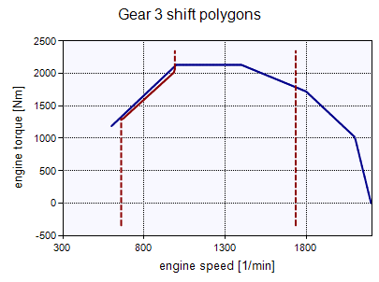
TUG FC-Based AMT Gearshift Strategy
Definition of gearshift lines
Upshift line
Vertical line at n_rated
Downshift line
Vertical line at 1.1 * n_idle speed up to Tq(n_idle * 1.1) * 0.98
Engine full-load curve -2% between n_idle and n_tq_99
Vertical line at n_tq_99
n_tq_99: lowest engine speed where the engine’s full-load curve reaches 99% of the max. torque

Slide 9
TUG FC-Based AMT Gearshift Strategy
The following parameters have to be provided in the shift parameter file (see for example "Examples\Class5_Tractor_4x2_AMT_TUG\ShiftParameters.vtcu")
Rating_current_gear
RatioEarlyDownshiftFC
RatioEarlyUpshiftFC

Slide 10
Classic AT Gearshift Strategy
Based on downshift (pre-shift) and upshift (post-shift) lines
For details please see the VECTO user manual
cont.

Slide 11
Voith AT Gearshift Strategy
The idea is described in ‘2019_03_25_New_gear_shift_logic_for_Vecto.pdf’, including documentation of the Matlab model
Limitation: not tested for gearboxes with 2 torque converter gears
cont.

Slide 12
Voith AT Gearshift Strategy
The following parameters have to be provided in the shift parameter file (see for example "Examples\CityBus_AT_GSVoith\ShiftParameters.vtcu")
LoadStageShiftLines contains the upshift and downshift lines for all load stages. An example is given "Examples\CityBus_AT_GSVoith\GearshiftLinesVoith.vgsv“. Details on the LoadStageShiftLines are provided on the next page
LoadStageThresholdsUp and LoadStageThresholdsDown is a string wit the thresholds for determining the individual thresholds, separated by semicolons (;) – see example
LoadStageShiftLines
LoadStageThresoldsUp
LoadStageThresoldsDown

Slide 13
Voith AT Gearshift Strategy
LoadStageShiftLines: compared to the documentation provided by Voith, VECTO uses a more general approach for defining the shift lines
Shift lines have to be defined for every load stage
For every load-stage, a shift line is defined for downhill (-5%), level (0%), and uphill (+5%)
For the shift lines, the shift speed for a_{min} and a_{max} have to be defined
For a vertical shift line, set a_{min} and a_{max} to the same value
In order to simplify the LoadStageShiftLines file, VECTO uses the following rules in case no value is provided in the input file
The shift speeds for a_{max} have to be provided in any case (downhill, level, uphill)
If the shift speeds for a_{min} are missing, the shift speeds for a_{max} are used

Slide 14
Voith AT Gearshift Strategy
LoadStageShiftLines: Example upshift 1 -> 2, load stage 1; values for amin
shift , LoadStage , n_dh_amax , n_level_amax , n_uh_amax , n_dh_amin , n_level_amin , n_uh_amin
1-2 , 1 , 650 , 680 , 725 , , ,
a
0% slope
a_{max}
a_{min}
680
n

Slide 15
Voith AT Gearshift Strategy
LoadStageShiftLines: Example upshift 1 -> 2, load stage 4
shift , LoadStage , n_dh_amax , n_level_amax , n_uh_amax , n_dh_amin , n_level_amin , n_uh_amin
…
1-2 , 4 , 650 , 680 , 725 , 670 , 700 , 745
…
a
0% slope
a_{max}
a_{min}
680
700
n

Slide 16
TUG FC-Based AT Gearshift Strategy
The shift strategy is based on gearshift lines for upshift and downshift (similar to the classic VECTO gearshift strategy) and uses the same principle as the FC-based AMT gearshift strategy
Allow early upshifts if the current engine operating point is within the gearshift lines if the following criteria are met:
Upshift: i_{gear+1} <= RatioEarlyUpshiftFC AND
FC_{gear +1} < FC_{gear} * Rating_current_gear
Allow early downshifts if the current engine operating point is within the gearshift lines if the following criteria are met:
Downshift: i_{gear-1} <= RatioEarlyDownshiftFC AND
FC_{gear -1} < FC_{gear} * Rating_current_gear
Limitation: not applicable for gearboxes with 2 torque converter gears at the moment

Slide 17
TUG FC-Based AT Gearshift Strategy
Gearshift lines can be provided as .vgbs file in the gearbox dialog for every gear
In case no gearshift lines are provided, the following shift lines are used
Upshift line
Vertical line at n_rated, converted to post-upshift speed via the transmission ratios
Downshift line
Vertical line at 1.1 * n_idle speed up to Tq(n_idle * 1.1) * 0.98
Engine full-load curve -2% between n_idle and n_tq_99
Vertical line at n_tq_99
n_tq_99: lowest engine speed where the engine’s full-load curve reaches 99% of the max. torque

Slide 18
VECTO Outputs
Depending on the selected gearshift strategy, the .vmod file contains additional columns, e.g., the calculated load stage for the AT-Voith proposal, or several intermediate results for the ACEA/Scania proposal
The .vsum file contains an additional column indicating the used gearshift strategy

